Slide 1
Masters Project Presentation
Mukesh Varma Saripella

Slide 2
Title
Project Title: Developing Rest API using Django and REACT JS
Author: Mukesh Varma Saripella
Advisor: Prof Mihaela Sabin
Date: 6th May 2021
Issue/Problem:
The primary purpose of this project is to find pros and cons in developing REST API when compared to Django Web Application. Taking effort and time into account lets evaluate which one is better.

Slide 3
Objectives
Analysing NHSEE web application to get good understanding of it.
Setting up virtual environment by installing required libraries and tools for project.
Running existing Django project in my local.
Now create Django project and create application inside it and include project details in settings.py file.
Create Models and serializers required for project.
Now based on project requirement develop views to perform GET,POST,UPDATE and DELETE operations.
In URLS.py specify path for each particular view.
Test end points in POSTMAN and validate them with CSV file.
In settings.py do CORS policy settings and add react js server details in wishlist.
Create React app and remove all unnecessary js code that comes with it.
Create a component folder and add header and footer js files in it
Develop header and footer using REACT BOOTSTRAP library.
Now using REACT ROUTER DOM we can toggle between tabs in navigation bar created earlier.
Now create react components for each particular end point and specify path in app.js
Use Axios to perform GET,POST, UPDATE and DELETE operations.
In few components I have used REACT SEMANTIC UI to show available libraries that we can use instead of bootstrap.
Now validate results of front end with JSON file.

Slide 4
Aproach
Tools and Requirements:
Postman
Conda Virtual Environment
Github
Frameworks Used:
Python Django REST Framework
REACT JS
Techniques and resources used:
Django serializer methods
CORS Policy
REACT BOOTSTRAP
REACT SEMANTIC UI
REACT ROUTER DOM

Slide 5
Cont..
Django Framework: Firstly create Django project and application in it and include database details, app details in settings.py file. Now create models and serlizers as per requirement. Develop views based on the requirement in existing application. In URL.py file specify path for each view and test those end points in Postman app. In settings.py we need to add CORS policy settings and add react js server details in wish list.
React JS: Now that we have our end points from backend. Create React application and remove unnecessary code in it. Create a folder components and include header and footer in it. Using react bootstrap develop navigation bar and footer for our application. Now create react components for each end point using axios. In order to navigate within header we need to specify path for each component in APP.js file using React router dom.

Slide 6
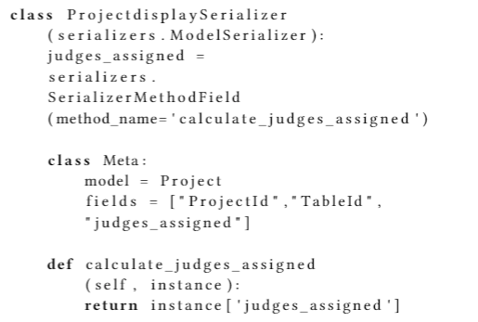
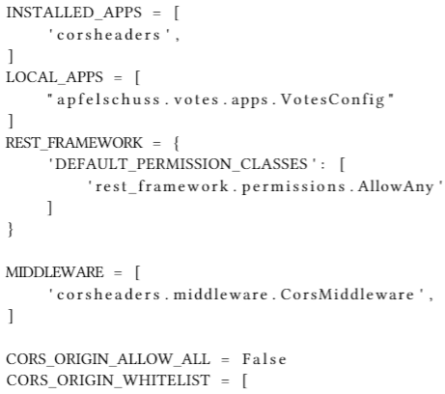
Results:
Django serializer methods: Used to include non model fields in JSON file
CORS policy settings: Its used to integrate two servers.

Slide 7


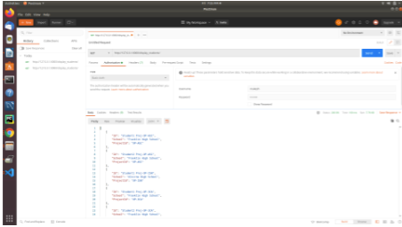
Cont..
React Bootstrap: Front end template is designed using it.
Postman: Used to test endpoints.

Slide 8
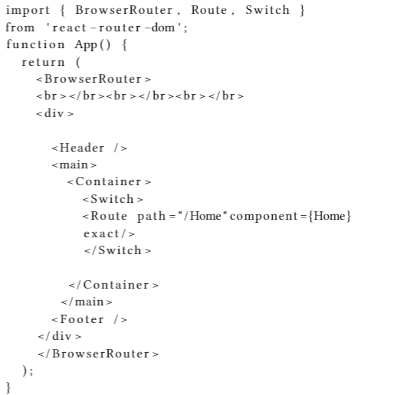
Cont..
React Router DOM is used to navigate between tab.

Slide 9
Evaluation:
Inorder to validate results of my backend I compared JSON results with CSV file using postman.
Coming to front end to test React Router dom and React semantic UI. We can check by toggling between tabs.
Axios can be tested by validating front end results with JSON data.
CORS policy is tested by fetching data from backend without server errors.
Limitations:
Need to work on update scenario for scoring tab.
Search functionality and page nation can be used for existing application.

